Slide 1
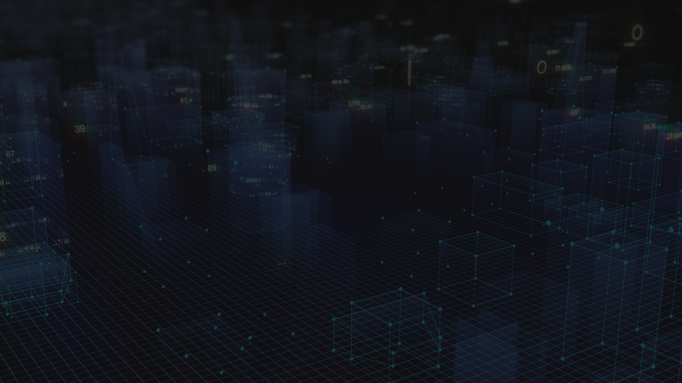


Train Delay
Prediction &
Railway Customer Care AI System
“Smart – AI-Powered Customer Support,Travel Planning”
StratQuest Finale

Slide 2



Meet the Team
Bishakha Mondal
KIIT DU
Arnab Laha
KIIT DU

Slide 3
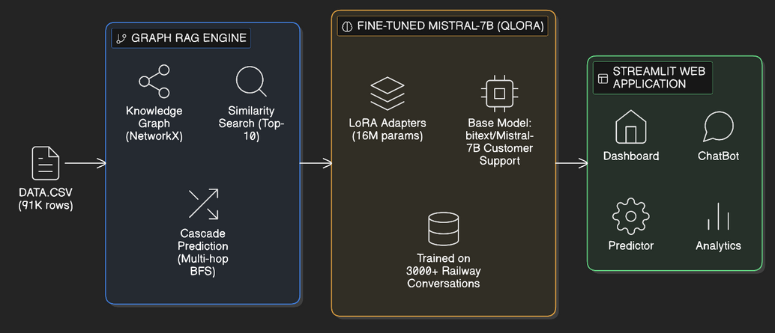



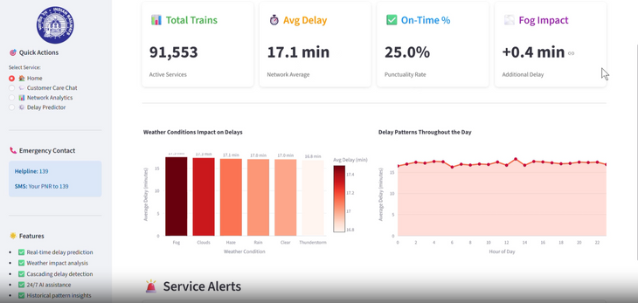
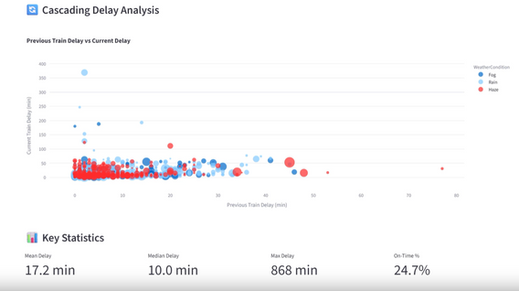
Introduction
An AI-powered railway customer care system that combines historical data, graph-based reasoning, and a fine-tuned large language model to predict train delays and provide explainable passenger assistance
Railway delays are highly context-dependent, influenced by factors such as weather conditions, time of day, and cascading effects from previous train operations, making traditional rule-based systems insufficient for accurate prediction.
There is a need for an intelligent, data-driven system that integrates historical railway data, contextual signals, and network intelligence to enable accurate delay prediction, proactive optimization, and professional passenger communication.

Slide 4
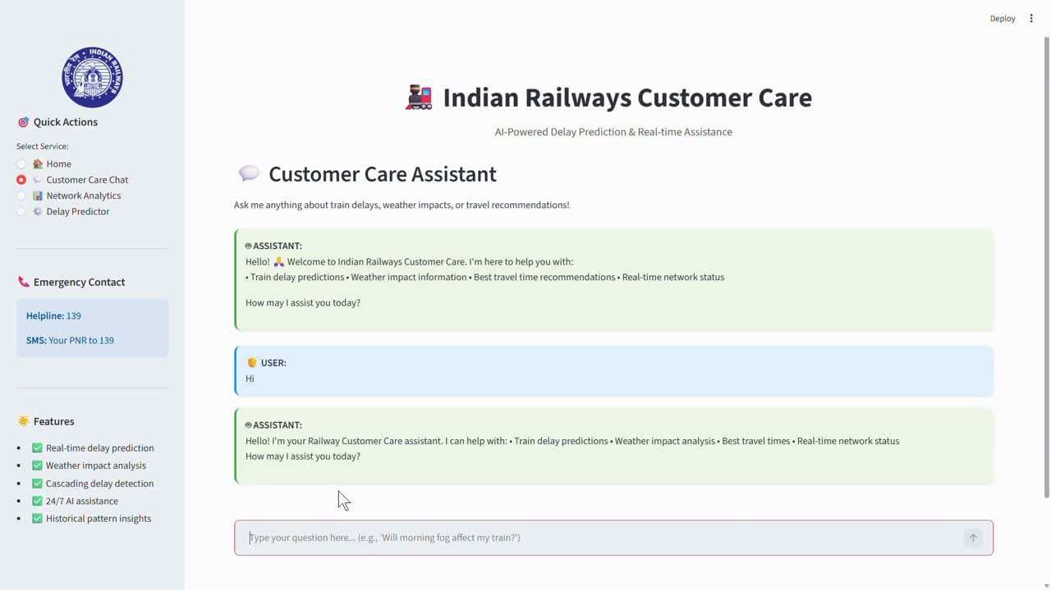

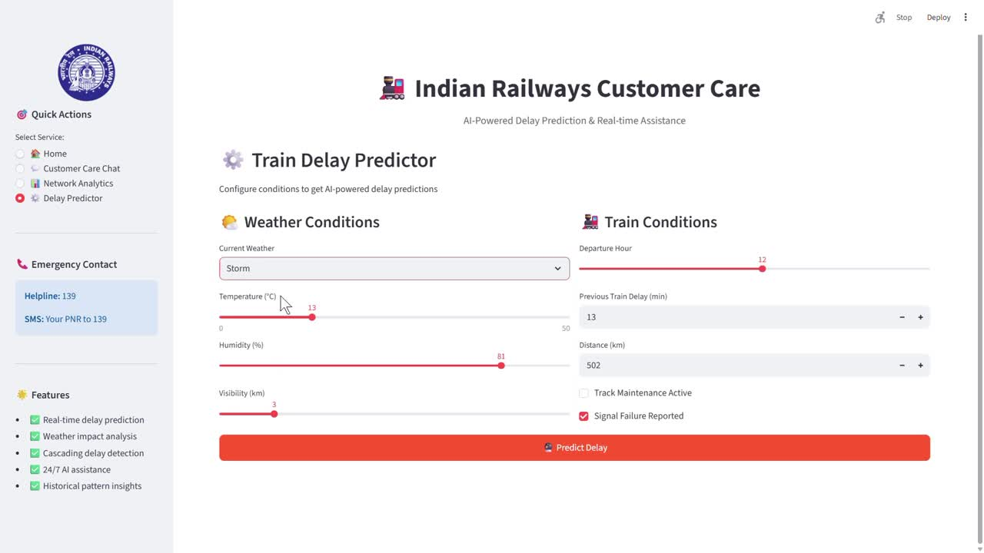
Video Pitch & Tech Stack
AI-Powered Customer Care Support :
Finetune Mistral-7B with QLoRA (PEFT) — parameter- efficient, context-aware delay reasoning and delivers empathetic, context-aware support.
It triggers tiered recovery—tracking minor delays or managing refunds for severe ones—while offering personalized tips to improve journeys
The Delay Predictor Component :
This hybrid engine processes 34 features and over 91,000 historical train records ,using Graph RAG and NetworkX. It calculates weather impacts and cascading network effects, ensuring accurate, grounded delay estimations with human-like explanations.

Slide 5
Proposed Solution Architecture
End-to-end pipeline integrating graph-based context retrieval with parameter-efficient LLM reasoning for real-time, explainable delay prediction
Data → Graph Modeling → Context Retrieval → LLM Reasoning → Response
Step 1: Data & Network Intelligence Layer
Large-scale historical railway dataset (91K+ train records, 34 features)
Graph-based representation of train operations
Detection of cascading delays across connected routes
Extraction of context signals: weather, time, delay severity
Step 2: Graph RAG
Construction of a railway knowledge graph
Retrieval of similar historical delay patterns
Network-level pattern analysis for robust context understanding
Generation of structured, context-rich inputs for downstream models
Step3: Fine-tuned(LoRA Enhanced LLM)
Mistral-7B with LoRA (QLoRA, 4-bit) fine-tuning
Lightweight adaptation (~16M trainable parameters)
Learning context-sensitive delay reasoning and response behavior
Efficient training with minimal computational overhead

Slide 6
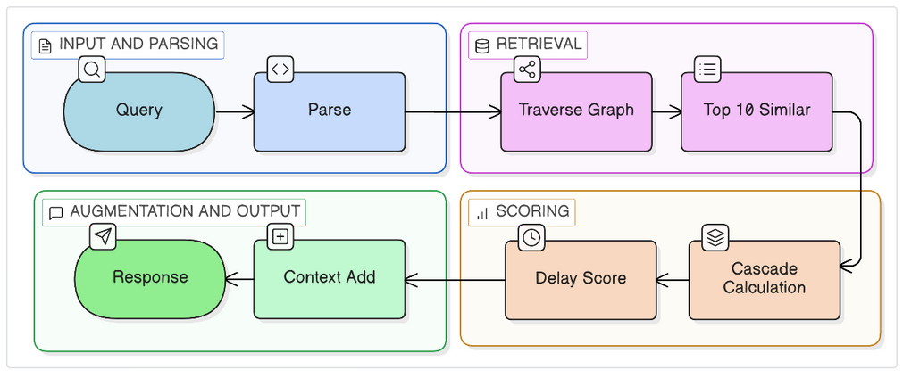
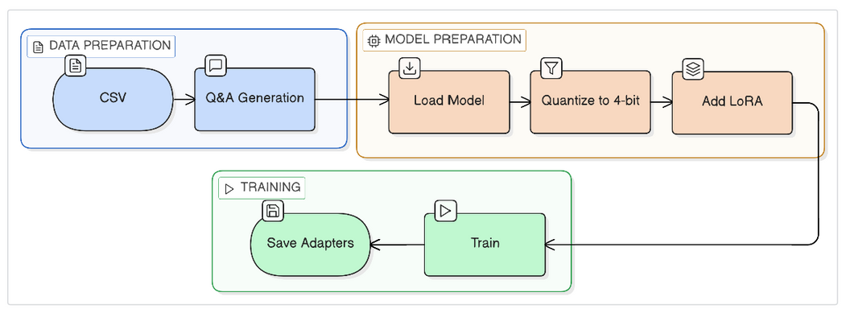
Challenges & Overcoming Them
Limitation of Pure GraphRAG:
LoRA-Enhanced Solution:
We create nodes for each train with attributes like delay, weather condition, and time of day. Edges connect consecutive trains, weighted by how much delay propagates. hen a user asks about fog delays, we traverse the graph to find the top 10 most similar historical cases — matching on delay range, weather condition, and time period.
Directly fine-tuned Mistral-7B using LoRA on raw railway text data. We add small trainable matrices to attention and MLP layers
This allowed the model to learn complex, implicit operational patterns while remaining computationally efficient, significantly improving prediction quality and providing human-like explanations

Slide 7
Conclusion & Future work
• Reduces passenger uncertainty with reliable predictions
• Improves travel experience through personalized guidance
• Cuts customer support load for Indian Railways
• Enables data-driven, proactive railway operations
• Shows how AI can improve daily life at national scale
• Real-time NTES integration for accurate live train updates
• Push notifications for early delay and cancellation alerts
• Native Android & iOS app for faster, wider access
• ML-based prediction of failures before delays occur
• Route optimization to suggest best alternatives during disruptions

Slide 8
THANK YOU

